Slide 1
Use Cases

Slide 2
Use Cases
Personalised Content:
Recommender systems help improve on-site experience by creatine dynamic content recommendations for different kinds of audiences like Netflix does.
Their machine learning platforms change the artwork depending on what you have watched in the past.

Slide 3
Use Cases
2. Better product search experience:
ML algorithms help to categories the products based on their features.
Example:- Material
Season
Colour, etc.

Slide 4
Example
Deep learning algorithms are capable of analyzing product images and breaking them down into specific attributes.
If we take the example of a dress: -
v-neck
a-line skirt
knee-length,etc.

Slide 5
Types of Recommender Systems

Slide 6
Types of Recommender Systems
There are two types of Recommender systems.
Content based filtering
Collaborative filtering

Slide 7
Content based filtering
The recommendation system filters the movie on the basis of its properties.
Content-based filtering recommendation also known as Cognitive filtering uses item features to recommend other items similar to what the users like on their previous actions or feedback.
It works by the data that is taken from the user either explicitly or implicitly.

Slide 8
Collaborative Filtering
Whenever we shop from Amazon or from other shopping sites, we are recommended some new products saying “Customers who bought this item also bought”.
This algorithm of recommending new items to a user based on the interests and preferences of other similar users is nothing but Collaborative filtering recommendation.

Slide 9
User based vs Item based
Collaborative filtering recommendation can be done in two ways:-
User based collaborative filtering.
Item based collaborative filtering.
In the user based filtering, we find out the similar users.
Whereas in the item based filtering, we find out the similar items.

Slide 10
Evaluation Metrics

Slide 11
Evaluation Metrics
There are many evaluation metrics for Recommender systems but we are going to discuss only four of them.
Mean average precision at K.
Coverage.
Personalisation.
Intralist similarity.

Slide 12
Mean average Precision at K
This evaluation metric gives an insight over how relevant the list of recommended items are.
Precision at k is the proportion of recommended items in the top-k set that are relevant.
This metric is available in the ML metrics library.

Slide 13
Coverage
Coverage is the percentage of items in the training data the model is able to recommend on a test set.
It is the percentage of possible recommendations that the system can predict.

Slide 14
Personalization
Personalization is a great way to assess if a model recommends many of the same items to different users.
It is the dissimilarity (1- cosine similarity) between user’s lists of recommendations.

Slide 15
Intralist similarity
Intralist similarity is the average cosine similarity of all items in a list of recommendations.
Calculation uses features of the recommended items to calculate the similarity.

Slide 16
Content Based Filtering

Slide 17
Content Based Filtering
Content here refers to content or attributes of products the Users like.
The idea in content-based filtering is to tag products using certain keywords, understand what the user likes, look up those keywords in database and recommend different products with same attributes.
Content Based Filtering uses the features of the items to recommend other items similar to the users based on their previous actions or explicit feedback.

Slide 18
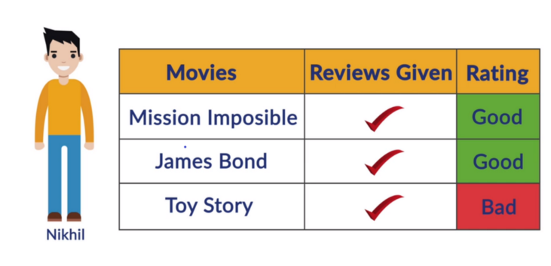

Slide 19
Collaborative Filtering

Slide 20
Collaborative Filtering
Collaborative Based Filtering will overcome the Disadvantage of Content Based Filtering as it is going to use the User Interactions Instead of the Content from the Items used by the Users.
Collaborative Filtering doesn’t need anything else except the user’s historical preference on a set of items.
It is based on historical data, the core assumption here is that the users who have agreed in the past tend to also agree in the future.

Slide 21
Collaborative Filtering
There are Two Types of Collaborative Based Filtering Techniques: -
User Based Collaborative Filtering.
Item Based Collaborative Filtering.

Slide 22
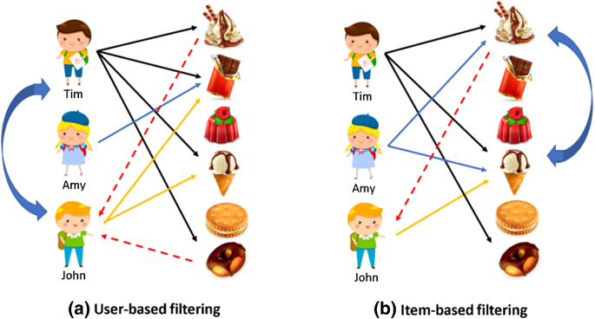

Slide 23
Use of Google Collaboratory

Slide 24
Use of Google Collaboratory
Two Major Reasons for using Google Collaboratory: -
Collaborative Filtering is Highly Computational.
It will require very High RAM, and Hence, It is better to use Cloud Services such as Google Colab which can Handle any Situation.
Installing scikit-surprise in Local System requires a lot of Pre-requisites.
Hence, It is again a Good choice to use Colab, where no prerequisites are required.

Slide 25
Advantages
&
Disadvantages

Slide 26
Content Based Filtering
Advantages:
The model doesn't need any data about other users, since the recommendations are specific to this user.
This makes it easier to scale to a large number of users.
The model can capture the specific interests of a user, and can recommend niche items that very few other users are interested in.

Slide 27
Content Based Filtering
Disadvantages:
Feature representation of the items are hand-engineered to some extent, this technique requires a lot of domain knowledge. Therefore, the model can only be as good as the hand-engineered features.
The model can only make recommendations based on existing interests of the user. In other words, the model has limited ability to expand on the users' existing interests.

Slide 28
Collaborative Based Filtering
Advantages:
It works Really well, even if the data is small.
The model can help users discover new interests. In isolation, the ML system may not know the user is interested in a given item, but the model might still recommend it because similar users are interested in that item.
No Need for Domain Knowledge.

Slide 29
Collaborative Based Filtering
Disadvantages:
It cannot Handle New Items, As the Model doesn’t get Trained on the Newly added Items in the Database. This Problem is known as the Cold Start Problem.
Side Features do not have much Importance.
Here Side Features can be referred to as Releasing Year, Name of Actors, etc in the Context of Movie Recommendations.

